Slide 1
Distributed Operating System for a Multi-Location Company
CO1AT3 – TECHNICAL PRESENTATION
CSA0415 – OPERATING SYSTEMS
GUIDED BY:
Dr.C.Chandravathi
PRESENTED BY:
Monal Raj.B(192511176)

Slide 2

Introduction
A Real-Time Operating System (RTOS) is designed to execute tasks within specified time limits.
Traffic signal control systems require accurate timing and quick responses to changing traffic conditions.
The RTOS manages sensors, signal lights, timers, and communication devices.
It ensures predictable and reliable operation of traffic signals.
Example: FreeRTOS, QNX, and VxWorks.

Slide 3
Type of OS and Its Characteristics
Type of OS and Its Characteristics
Type: Real-Time Operating System (RTOS)
Deterministic Response: Responds to events within predictable time limits.
Low Latency: Processes sensor inputs and interrupts quickly.
Priority-Based Scheduling: Gives critical traffic-control tasks higher priority.
Reliability: Helps maintain stable operation of traffic signals.
Multitasking: Allows sensor monitoring, timer management, and signal control to operate concurrently.
Deadline Management: Ensures that signal changes occur at the required time.

Slide 4
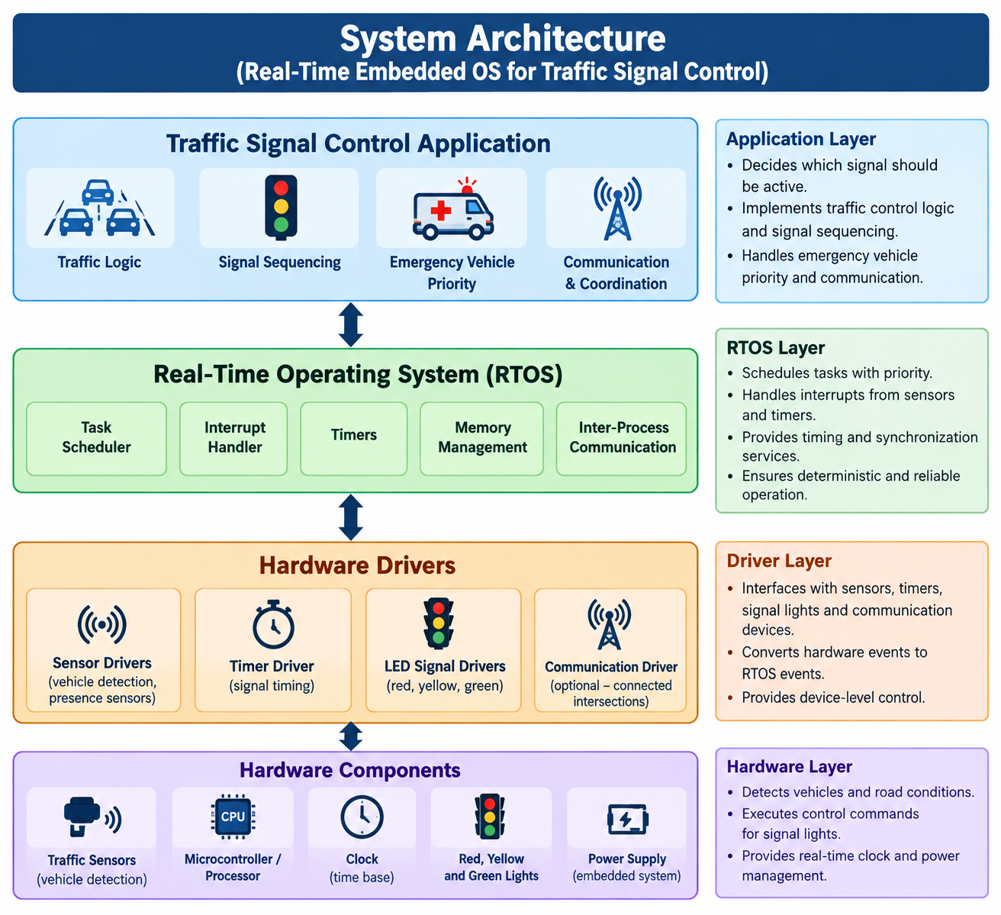
System Architecture

Slide 5
System Calls for Communication and Coordination
System Calls for Process Control and Timing
Process Control System Calls
fork() – Creates a new process in operating systems that support process creation.
exec() – Replaces the current process with a new program.
wait() / waitpid() – Waits for a child process to finish.
getpid() – Returns the process ID of the current process.
kill() – Sends a signal to a process; its use must be carefully controlled in real-time applications.
Timing System Calls
clock_gettime() – Reads the current time from a specified clock.
clock_nanosleep() – Suspends execution until a specified time or duration.
timer_create() – Creates a timer that can notify a process when it expires.
timer_settime() – Starts or configures a timer.
nanosleep() – Suspends a process for a specified time.

Slide 6
Application in a Multi-Location Company
Application in Traffic Signal Control
Vehicle Detection: Sensors detect vehicles waiting at intersections.
Signal Timing: Timers control the duration of red, yellow, and green lights.
Task Scheduling: High-priority safety and signal-control tasks are executed promptly.
Emergency Vehicle Priority: The system can prioritize emergency vehicles when supported by suitable sensors and control logic.
Coordination: Communication between nearby traffic signals helps improve traffic flow.
Fault Handling: The system detects faults and switches to a predefined safe state.

Slide 7
Conclusion
An RTOS is suitable for traffic signal control because it provides predictable task execution and timing.
Its scheduler, interrupt handler, and timer services support time-critical operations.
Process-control and timing APIs help manage execution and scheduled events.
Proper priority assignment and fault handling improve system reliability and traffic safety.
Therefore, an RTOS is an effective choice for real-time embedded traffic-control applications.

Slide 8
THANK YOU

